Slide 1


Large-Scale Object Recognition using Label Relation Graphs
Jia Deng^{1,2}, Nan Ding², Yangqing Jia², Andrea Frome², Kevin Murphy²,
Samy Bengio², Yuan Li², Hartmut Neven², Hartwig Adam²
University of Michigan¹, Google²

Slide 2
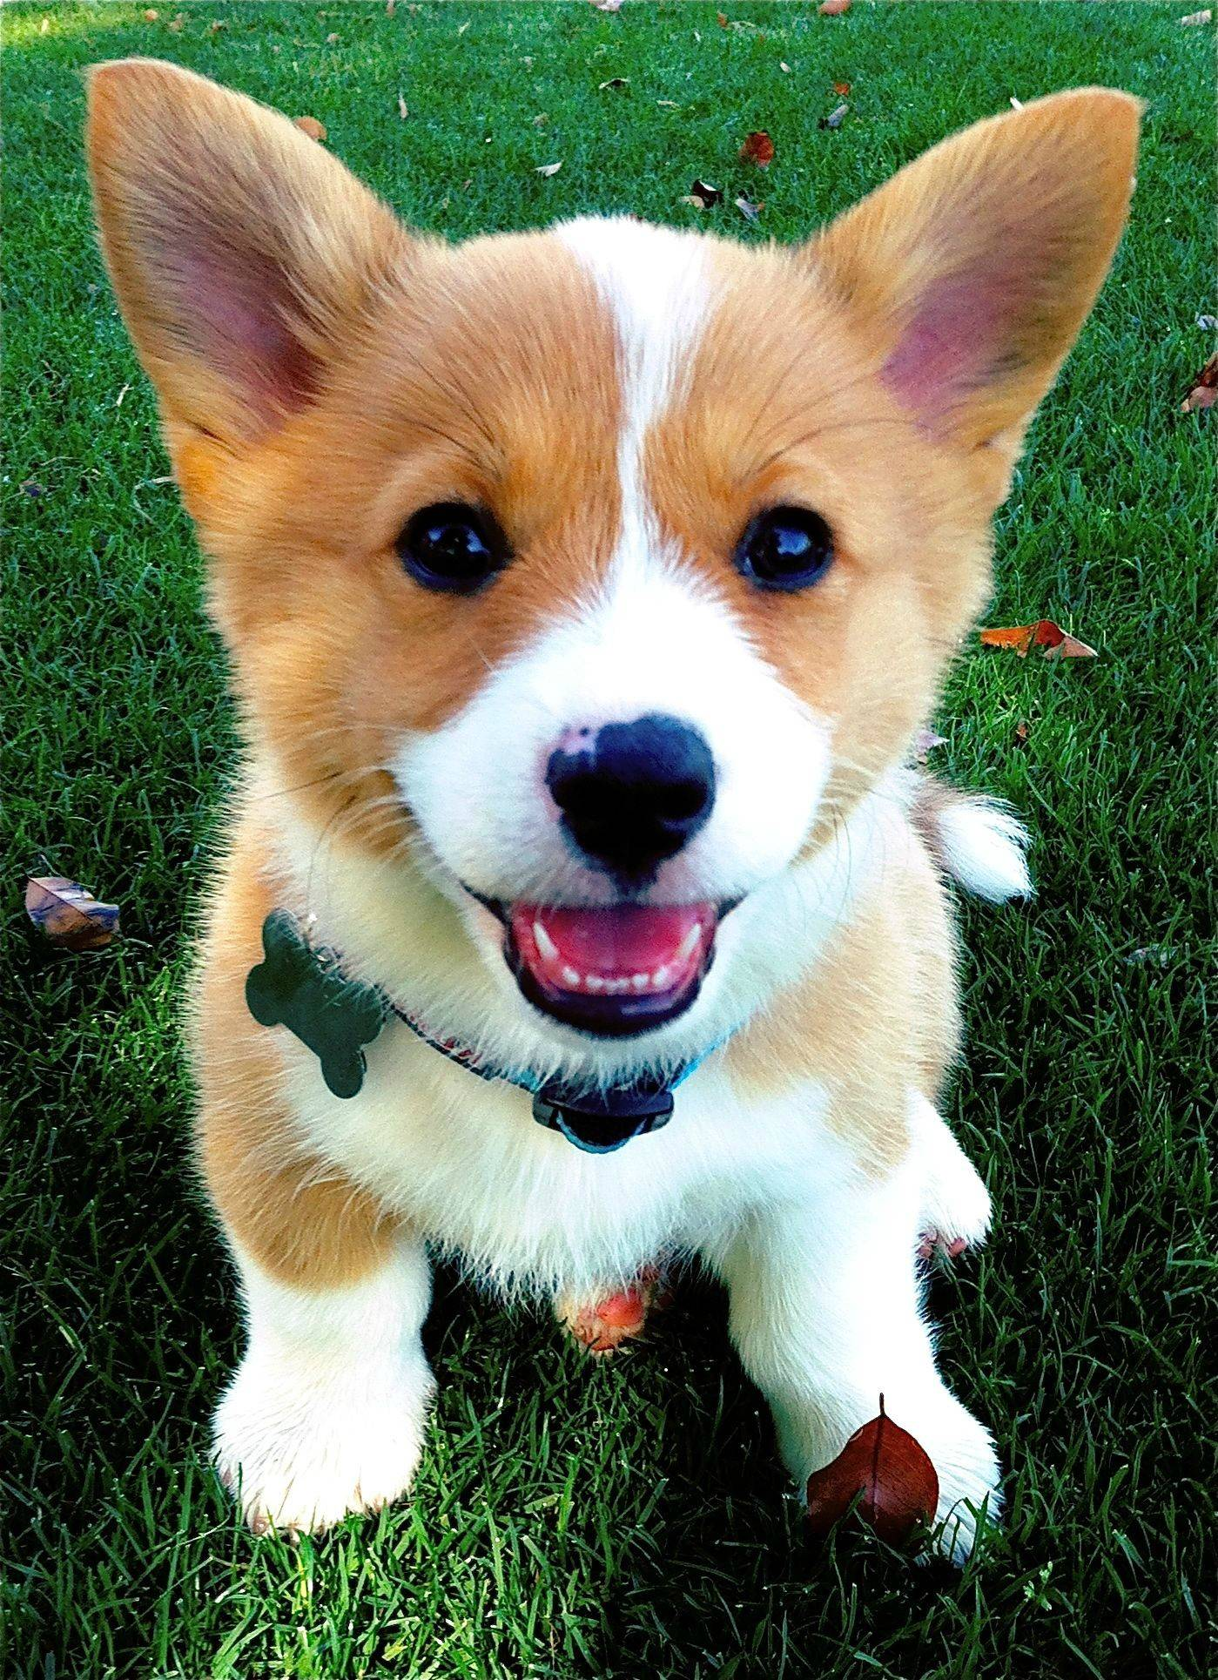
Object Classification
Assign semantic labels to objects
Dog
✔
Corgi
✔
Puppy
✔
Cat
✖

Slide 3
Object Classification
Assign semantic labels to objects
Probabilities
Dog
0.9
Corgi
0.8
Puppy
0.9
Cat
0.1

Slide 4
Object Classification
Assign semantic labels to objects
Features
Classifier
Probabilities
Feature Extractor
Dog
0.9
Corgi
0.8
Puppy
0.9
Cat
0.1

Slide 5
Object Classification
Independent binary classifiers: Logistic Regression
Dog
0.2
No assumptions about relations.
Corgi
0.8
Puppy
0.6
Cat
0.4
Multiclass classifier: Softmax
Dog
/
0.2
Corgi
Assumes mutual exclusive labels.
/
0.4
Puppy
/
0.3
/
Cat
0.1
+

Slide 6
Object labels have rich relations
Exclusion
Hierarchical
Dog
Dog
Cat
Corgi
Puppy
Cat
Corgi
Puppy
Overlap
Softmax: all labels are mutually exclusive ☹
Logistic Regression: all labels overlap ☹

Slide 7
Goal: A new classification model
Respects real world label relations
Dog
Cat
Dog
0.9
Corgi
0.8
Puppy
0.9
Cat
0.1
Corgi
Puppy

Slide 8
Visual Model + Knowledge Graph
Visual
Model
Knowledge
Graph
Dog
0.9
Joint Inference
Corgi
0.8
Puppy
0.9
Cat
0.1
Assumption in this work:
Knowledge graph is given and fixed.

Slide 9
Agenda
Encoding prior knowledge (HEX graph)
Classification model
Efficient Exact Inference
Experiments
Conclusion and Future Work

Slide 10
Agenda
Encoding prior knowledge (HEX graph)
Classification model
Efficient Exact Inference
Experiments
Conclusion and Future Work

Slide 11
Hierarchy and Exclusion (HEX) Graph
Exclusion
Hierarchical
Dog
Cat
Corgi
Puppy
Hierarchical edges (directed)
Exclusion edges (undirected)

Slide 12
Examples of HEX graphs
Person
Dog
Cat
Red
Shiny
Male
Female
Child
Car
Bird
Round
Thick
Boy
Girl
Mutually exclusive
All overlapping
Combination

Slide 13
State Space: Legal label configurations
Each edge defines a constraint.
Dog
Cat
Dog | Cat | Corgi | Puppy
0 | 0 | 0 | 0
0 | 0 | 0 | 1
0 | 0 | 1 | 0
0 | 0 | 1 | 1
1 | 0 | 0 | 0
…
1 | 1 | 0 | 0
1 | 1 | 0 | 1
…
Corgi
Puppy

Slide 14
State Space: Legal label configurations
Each edge defines a constraint.
Dog
Cat
Dog | Cat | Corgi | Puppy
0 | 0 | 0 | 0
0 | 0 | 0 | 1
0 | 0 | 1 | 0
0 | 0 | 1 | 1
1 | 0 | 0 | 0
…
1 | 1 | 0 | 0
1 | 1 | 0 | 1
…
Corgi
Puppy
Hierarchy: (dog, corgi) can’t be (0,1)

Slide 15
State Space: Legal label configurations
Each edge defines a constraint.
Dog
Cat
Dog | Cat | Corgi | Puppy
0 | 0 | 0 | 0
0 | 0 | 0 | 1
0 | 0 | 1 | 0
0 | 0 | 1 | 1
1 | 0 | 0 | 0
…
1 | 1 | 0 | 0
1 | 1 | 0 | 1
…
Corgi
Puppy
Hierarchy: (dog, corgi) can’t be (0,1)
Exclusion: (dog, cat) can’t be (1,1)

Slide 16
Agenda
Encoding prior knowledge (HEX graph)
Classification model
Efficient Exact Inference
Experiments
Conclusion and Future Work

Slide 17
HEX Classification Model
Pairwise Conditional Random Field (CRF)
Input scores
Binary Label vector

Slide 18
HEX Classification Model
Pairwise Conditional Random Field (CRF)
Input scores
Binary Label vector
Unary: same as logistic regression

Slide 19
HEX Classification Model
Pairwise Conditional Random Field (CRF)
Input scores
Binary Label vector
If violates constraints
0
Otherwise
Unary: same as logistic regression
Pairwise: set illegal configuration to zero
→ All illegal configurations have probability zero.

Slide 20
HEX Classification Model
Pairwise Conditional Random Field (CRF)
Input scores
Binary Label vector
Partition function: Sum over all (legal) configurations

Slide 21
HEX Classification Model
Pairwise Conditional Random Field (CRF)
Input scores
Binary Label vector
Probability of a single label: marginalize all other labels.

Slide 22
Special Case of HEX Model
Softmax
Logistic Regressions
Dog
Cat
Red
Shiny
Car
Bird
Round
Thick
Mutually exclusive
All overlapping

Slide 23
Learning
Dog
1
Corgi
?
Puppy
?
Cat
?
Label: Dog
DNN
Dog
Cat
Puppy
Corgi
Back Propagation
Maximize marginal probability of observed labels

Slide 24
Agenda
Encoding prior knowledge (HEX graph)
Classification model
Efficient Exact Inference
Experiments
Conclusion

Slide 25
Naïve Exact Inference is Intractable
Inference:
Computing partition function
Perform marginalization
HEX-CRF can be densely connected (large treewidth)

Slide 26
Observation 1: Exclusions are good
Dog
Cat
Car
Bird
Number of legal states is O(n), not O(2^{n}).
Lots of exclusions → Small state space → Efficient inference
Realistic graphs have lots of exclusions.
Rigorous analysis in paper.

Slide 27
Observation 2: Equivalent graphs
Dog
Cat
Dog
Cat
Corgi
Corgi
Puppy
Puppy
Cardigan Welsh Corgi
Pembroke Welsh Corgi
Cardigan Welsh Corgi
Pembroke Welsh Corgi

Slide 28
Observation 2: Equivalent graphs
Dog
Cat
Dog
Cat
Dog
Cat
Corgi
Corgi
Corgi
Puppy
Puppy
Puppy
Cardigan Welsh Corgi
Pembroke Welsh Corgi
Cardigan Welsh Corgi
Pembroke Welsh Corgi
Cardigan Welsh Corgi
Pembroke Welsh Corgi
Sparse equivalent
Small Treewidth ☺
Dynamic programming
Dense equivalent
Prune states ☺
Can brute force

Slide 29
HEX Graph Inference
C
2.Build Junction Tree (offline)
B
A
F
A
B
C
F
1. Sparsify (offline)
B
G
B
C
D
A
F
G
C
E
D
E
F
B
G
5. Message Passing on legal states (online)
D
4.Prune Clique States (offline)
E
F
C
3.Densify (offline)
B
A
F
A
B
F
C
B
B
C
G
G
D
F
D
E
F
E

Slide 30
Agenda
Encoding prior knowledge (HEX graph)
Classification model
Efficient Exact Inference
Experiments
Conclusion and Future Work

Slide 31
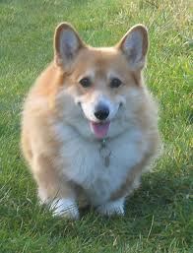
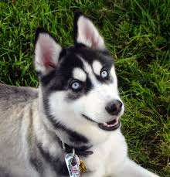
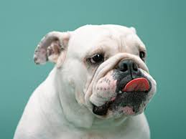
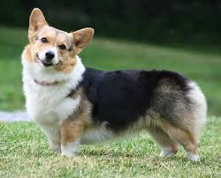
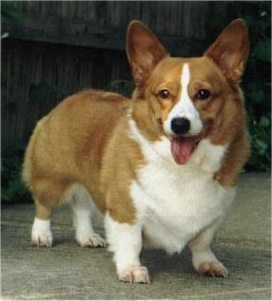
Exp 1: Learning with weak labels
Many basic category labels
Few fine-grained labels
Animal
Dog
…
…
Weak labels: No information on subcategories.
Corgi

Slide 32
Exp 1: Learning with weak labels
Dog
1
Corgi
?
Puppy
?
Cat
?
Label: Dog
DNN
Dog
Cat
Puppy
Corgi
Hypothesis: HEX models can improve fine-grained recognition using basic level labels.

Slide 33
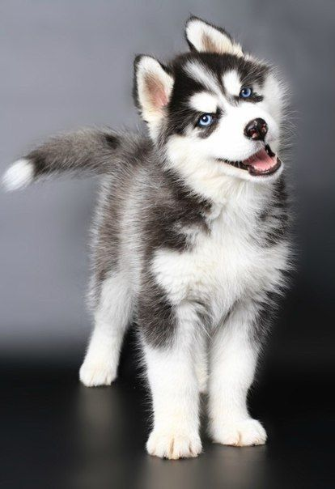
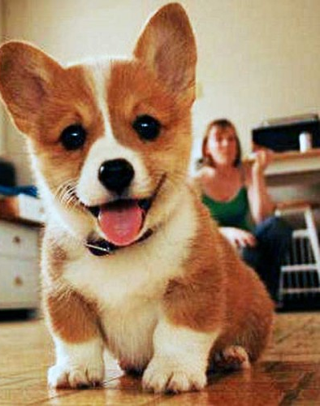
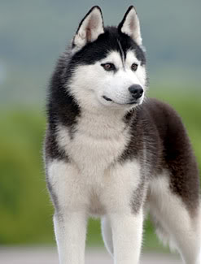
Exp 1: Learning with weak labels
ILSVRC 2012: “relabel” or “weaken” a portion of fine-grained leaf labels to basic level labels.
Evaluate on fine-grained recognition
Animal
Animal
Animal
Dog
Relabel
Dog
Dog
…
…
…
Corgi
Husky
Corgi
Husky
Corgi
Husky
Original ILSVRC 2012 (leaf labels)
Training
(“weakened” labels)
Test

Slide 34
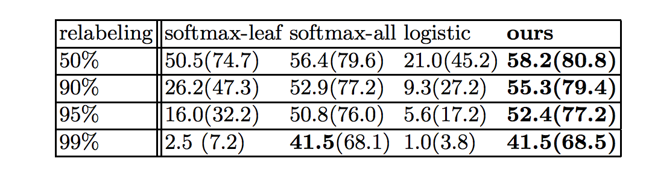
Exp 1: Learning with weak labels
ILSVRC 2012: “relabel” or “weaken” a portion of fine-grained leaf labels to basic level labels.
Evaluate on fine-grained recognition.
Consistently outperforms baselines.
Top 1 accuracy (top 5 accuracy)

Slide 35
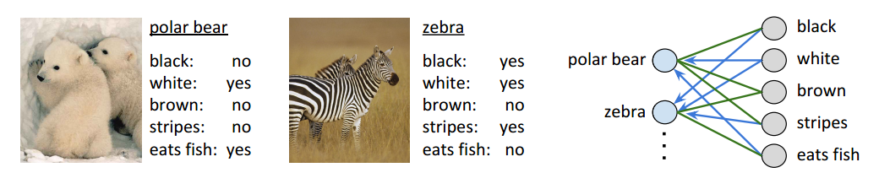
Exp 2: Zero-Shot Recognition using Object-Attribute Knowledge
polar bear
zebra
black
polar bear
white
black: no
white: yes
brown: no
stripes: no
black: yes
white: yes
brown: no
stripes: yes
brown
zebra
stripes
…
…
Animals with Attribute (AwA) dataset (Lampert et al. 2009)
Training:
Observe only a subset of animal labels.
Given all animal-attribute relations
Indirectly learns attributes.
Test: predict new classes with no images in training.
DAP (Lampert et al.) | IAP (Lampert et al.) | Ours
40.5% | 27.8% | 38.5%

Slide 36
Related Work
Multilabel Annotation & Hierarchy
[Lampert et al. NIPS’11]
[Chen et al. ICCV’11]
[Bi & Kwok, NIPS’12]
[Bucak et al. CVPR’11]
Ours: Unifies hierarchy and exclusion.
Transfer learning & Attributes
[Rohrbach et al. CVPR’10]
[Lampert et al. CVPR’09]
[Kuettel et al. ECCV’12]
[Akata et al. CVPR’13]
Ours: A classification model that allows transferring.
Extracting Common Sense Knowledge
[Chen et al. ICCV’13]
[Zitnick & Parikh CVPR’13]
Ours: Assumes knowledge is given.
[Hwang et al. CVPR’11]
[Kang et al. CVPR’06]
[Marszalek & Schmid CVPR’07]
[Zweig & Weinshall CVPR’07]
Visual
Model
[Farhadi et al. CVPR’10]
[Lim et al. NIPS’11]
[Yu et al. CVPR’13]
[Fergus et al. ECCV’10]
External Knowledge
[Zhu et al. ECCV’14]
[Fouhey & Zitnick CVPR’14]

Slide 37
Conclusions
A unified framework for single object classification
Generalizes standard classification models
Leverages a knowledge graph
Efficient exact inference
Future work
Non-absolute relations
Spatial relations between object instances

